Slide 1
Characterizing and Predicting Early Reviewers for Effective Product on Ecommerce Websites
Presented By :
SIRIPURAPU SANDEEP KUMAR-(19000I0032)
MITUKULA ANIL-(19000I0031)
Under The Guidance Of :
M.Venugopal Reddy
Assistant Professor
Department of Computer science ,KU

Slide 2
Content
Abstract
Introduction
Existing System
Dis-Advantages of Existing System
Proposed System
Advantages of Proposed System
Hardware and Software Requirements
Class Diagram
System Architecture
Implementation
Outputs
Conclusion

Slide 3
ABSTRACT
➢
Online reviews have become an important source of
information for users before making an informed purchase decision.
Early reviews of a product tend to have a high impact on the subsequent product sales.
Here, we take the initiative to study the behavior characteristics of early reviewers through their posted reviews on two real-world large e-commerce platforms, i. e., Amazon and Yelp.

Slide 4
INTRODUCTION
The emergence of e-commerce websites has enabled users to publish or share purchase experiences by posting product reviews, which usually contain useful opinions, comments and feedback towards a product.
To analyse the characteristics of early reviewers, we take two important metrics associated with their reviews., their review ratings and helpfulness scores assigned bothers. We have found that (1) an early reviewer tends to assign a higher average rating score to products; and (2)an early reviewer tends to post more helpful reviews.
Our analysis also indicates that early reviewers’ ratings and received helpfulness scores are likely to inﬂuence product popularity.

Slide 5
EXISTING SYSTEM
➢In the existing system, the term of early adopter originates from the classic theory for Diffusion of Innovations. An early adopter could refer to a trendsetter, e.g., an early customer of a given company, product and technology. The importance of early adopters has been widely studied in sociology and economics. It has been shown that early adopters are important in trend prediction, viral marketing, product promotion, and so on the existing system.
As for product marketing, consumers frequently select popular brands because they believe that popularity indicates better quality.
With the rapid growth of online social platforms and the availability of a high volume of social networking data, studies of the diffusion of innovations have been largely conducted on social networks, including resource-constrained networks, following or retweet networks, user-click graphs and text-based innovation networks.
•

Slide 6
DISADVANTAGES OF EXISTING SYSTEM
There is no estimating the Product Lifetime which results no early review detections.
There is no early reviewer which tends to assign a higher average rating scores.

Slide 7
PROPOSED SYSTEM
The proposed system presents a ﬁrst study to characterize e-commerce website using two real-world large datasets.
early reviewers on an
In the proposed system, the system quantitatively analyzes the characteristics of early reviewers and their impact on product popularity. Our empirical analysis provides support to a series of theoretical conclusions from the sociology and economics.
The system views review posting process as a multiplayer competition game and develop a embedding-based ranking model for the prediction of early reviewers. Our model can deal with the cold-start problem by incorporating side information of products.
Extensive experiments on two real-world large datasets, i.e., Amazon and Yelp have demonstrated the effectiveness of our approach for the prediction of early reviewers.

Slide 8
ADVANTAGES
The system determining the Complete Review Time Span.
Fast technique to Review Spammer Detection and Removal.

Slide 9
SOFTWARE REQUIREMENTS
Operating System - Windows XP
Coding Language
- Java/J2EE
(JSP,Servlet)
Front End
- J2EE
Back End
- MySQL

Slide 10
HARDWARE REQUIREMENTS
Processor
- Pentium –IV
RAM
- 4 GB (min)
Hard Disk
- 20 GB
Key Board
- Standard Windows Keyboard
Mouse
- Two or Three Button Mouse
Monitor
- SVGA

Slide 11
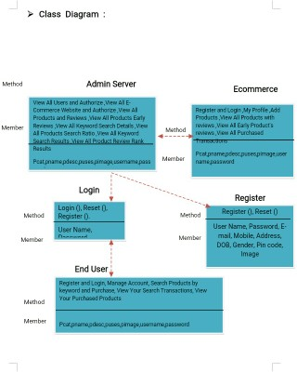
CLASS DIAGRAM

Slide 12
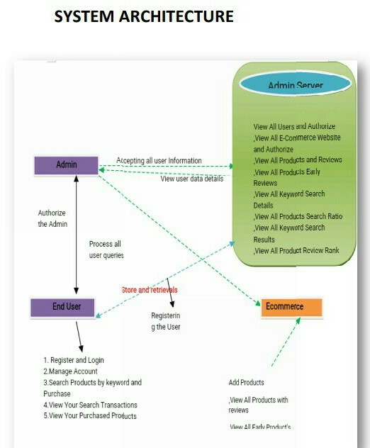
SYSTEM ARCHITECTURE

Slide 13
IMPLEMENTATION^{• My Proﬁle}
E –COMMERCE WEBSITE
ADMIN
View All Users and Authorize
View All E-Commerce Website and Authorize
View All Products and Reviews
View All Products Early Reviews
View All Keyword Search Details
View All Products Search Ratio
View All Keyword Search Results
Add Products
View All Products with reviews
View All Early Product's reviews
View All Purchased Transactions
END USER
Register and Login
Manage Account
Search Products by keyword and Purchase
View Your Search Transactions
View Your Purchased Products

Slide 14

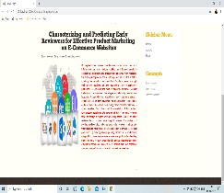
OUTPUT

Slide 15
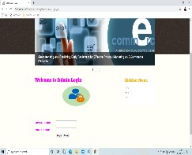

ADMIN PAGE

Slide 16
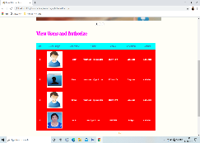
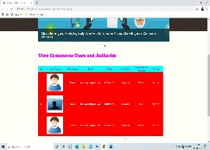
ADMIN
View ecommerce users and authorize
View users and authorize

Slide 17
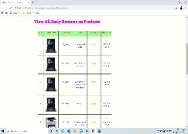
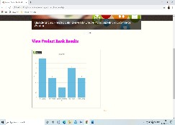
ADMIN
VIEW ALL EARLY REVIEWS
VIEW PRODUCT RANK RATIO

Slide 18

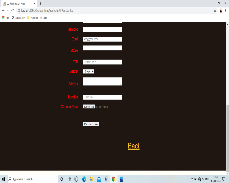
USER
REGISTRATION PAGE
REGISTRATION PAGE

Slide 19
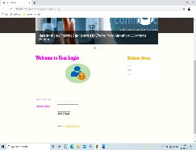

USER
LOGIN PAGE
HOME PAGE

Slide 20
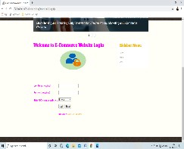

E-COMMERCE WEBSITE USER

Slide 21
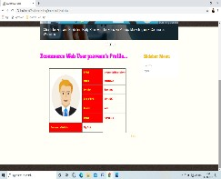
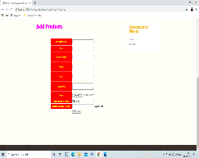
E-COMMERCE WEBSITE USER

Slide 22
CONCLUSION
An early reviewer tends to assign a higher average rating score.
An early reviewer tends to post more helpful reviews. Our experiments also indicate that early reviewers’ ratings and their received helpfulness scores are likely to inﬂuence product popularity at a later stage.
In the future, we will explore effective ways in incorporating review content into our early reviewer prediction model.
We will investigate this task with real e-commerce cases in collaboration with e-commerce companies in the future.

Slide 23
THANK YOU

